Slide 1
Survey: Procedures
Preprocessing
Feature Extraction
Feature Selection
Classification

Slide 2
Survey: Feature Extraction
Statistical features (whole brain/ROIs)
Volume, cortical thickness
Cortical information
Texture features (using PyRadiomics)
First-order: average, central moments, entropy
Second-order: GLCM, GLSZM, run length matrix
Raw voxels
Anatomical ROI-based
Statistical voxel-based

Slide 3
Survey: Feature Extraction
VBM
Segmentation
ROI Atlas
T1
GM, WM
Anatomical ROIs
Voxel-based ROIs
Statistical Information
Based on Voxels
Texture Features
Raw Voxels
1st-order, 2nd-order
(avg, entropy, glcm …)
Further processing
volume, cortical thickness,
asymmetry degree …

Slide 4
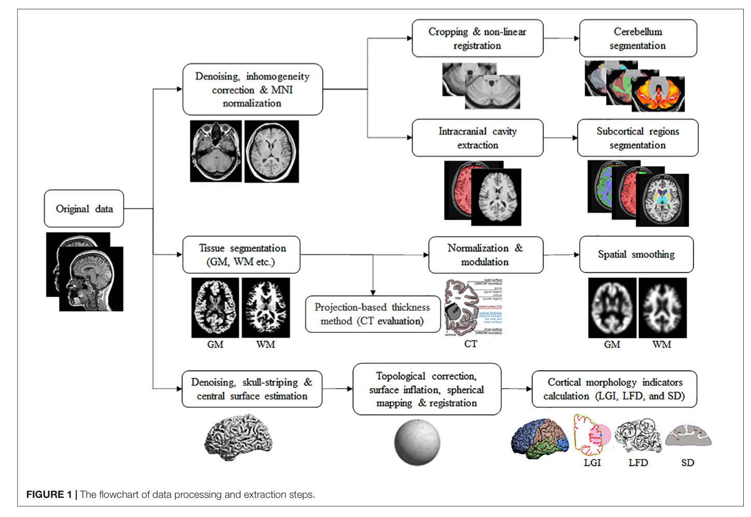
Survey: Feature Extraction (statistical features)
Volume: GM, WM, subcortical
CT (cortical thickness)
AI (asymmetry degree)
LGI: the degree of gyrification at the vertex level
LFD: structural complexity in the cerebral cortex
SD: the linear distance from the inner surface of the brain to the outer surface

Slide 5
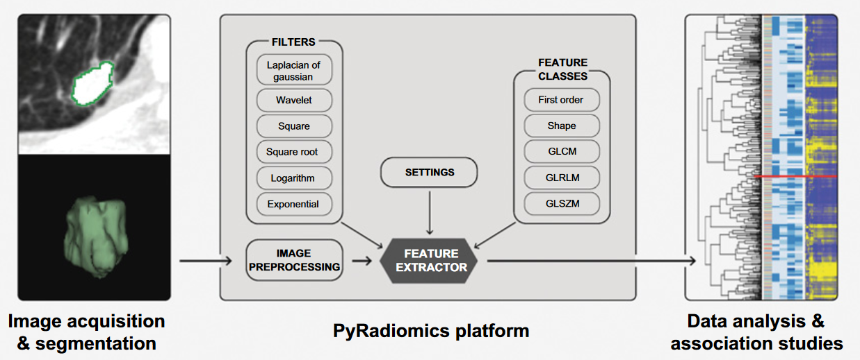
Survey: Feature Extraction (texture features)

Slide 6
Survey: Feature Extraction (texture features)
Texture features extracted by PyRadiomics
First-order: Statistical
avg, variance, kurtosis, skewness, energy …
Shape:
Not used due to registration (all ROIs have the same shape)
GLCM: Gray Level Co-occurrence Matrix
The distribution of co-occurring pixel values at a given offset
GLRLM: Gray Level Run Length Matrix
A line of pixels in a certain direction with the same intensity value
GLSZM: Gray Level Size Zone Matrix
The number of connected voxels that share the same gray level intensity
GLDM: Gray Level Dependence Matrix
The number of connected voxels within distance that are dependent on the center voxel

Slide 7
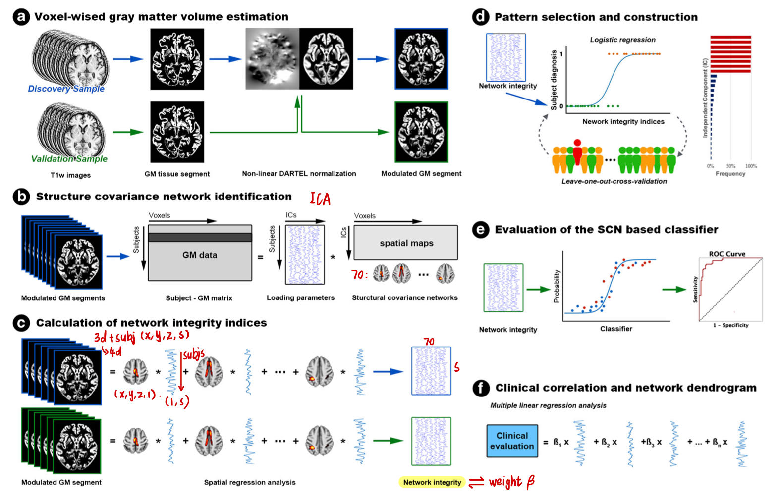
Survey: Feature Extraction (raw voxels)
PCA
ICA

Slide 8
Survey: Feature Selection
Data-driven methods
mRMR(最大相关和最小冗余), PCA, ICA
Statistical methods
T-test, Chi2, Pearson’s Correlation Coefficient
Regression/Classification models
LASSO

Slide 9
Survey: Feature Selection (N=11)
LASSO: 6
mRMR: 3
PCA:3
Pearson’s Correlation Coefficient: 2
NCA, Chi2, ReliefF, ReliefA, t-test, ILFS, LLBCFS, UMCFS, MDFSA, CSFA, FSASL, UFSOL …

Slide 10
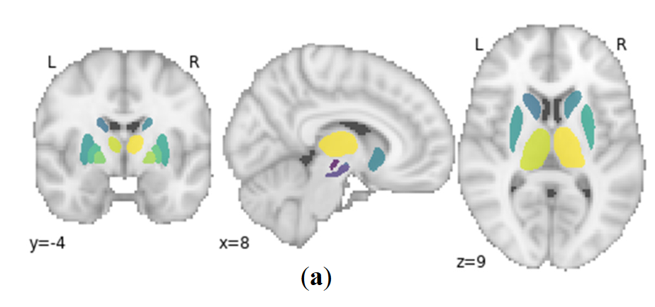
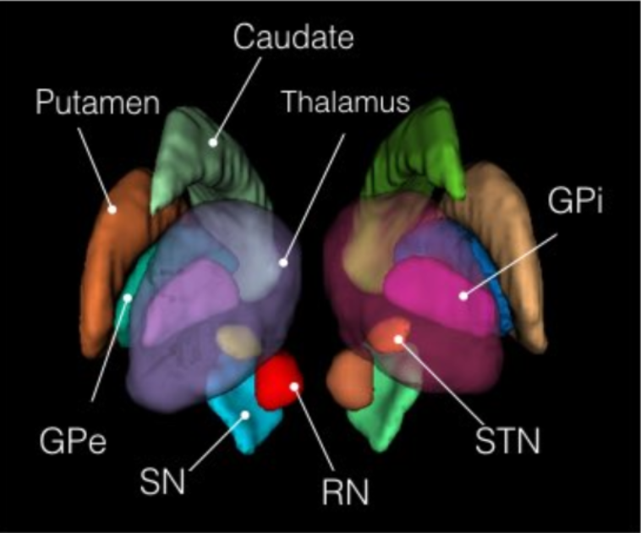
Survey: ROIs

Slide 11
Pipeline:
Demo
age, sex
AUC
Demo
Clinic
Demo
Clinic
Demo
Clinic
Img
Clinic
u3, ledd, duration
Classifiers
PPMI
Demo
Clinic
Img
Img
radiomics
Bootstrap N=1000
Feature Selection
CI, t-test
CAT
Pos: >0.3
Neg: <=0.3
Output

Slide 12
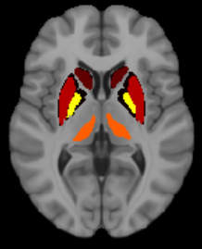
Pipeline: PPMI Data
Skull Strip
FSL BET
Registration
ANTs AntsRegistration
PD25-T1MPRAGE-template-1mm.nii.gz
Demographic
age, sex
Clinical
u3, ledd, duration
PPMI
Segmentation
PyRadiomics w/ atlas
PD25-subcortical-1mm.nii.gz
Img
T1 MPRAGE
ROIs: 8*2
RN, SN,
STN, CAU,
PUT, GPe,
GPi, THA
CAT (output of the classifiers)
Pos (annotated as 1): response rate>0.3
Neg (annotated as 0): : response rate <=0.3

Slide 13
Pipeline: Image Feature Extraction
T1
PyRadiomics
Radiomics: 86*16
Firstorder
GLCM
GLRLM
GLSZM
GLDM
ROIs: 8*2
RN, SN,
STN, CAU,
PUT, GPe,
GPi, THA

Slide 14
Pipeline: Feature Selection
Initial
Correlation
mRMR
LASSO
RFE
N=86*16
N=222
Top 50
N=5
N=4
Selected Features: rTHA_original_gldm_LargeDependenceHighGrayLevelEmphasis
lGPi_original_glcm_Correlation
rCAU_original_glszm_LargeAreaHighGrayLevelEmphasis
rCAU_original_glcm_Idn

Slide 15
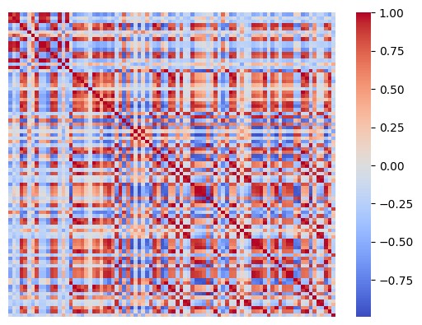
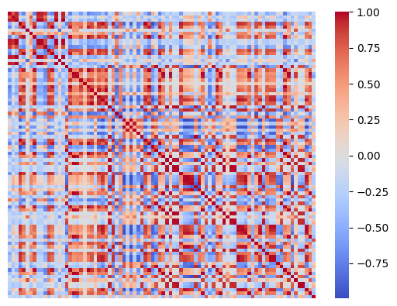
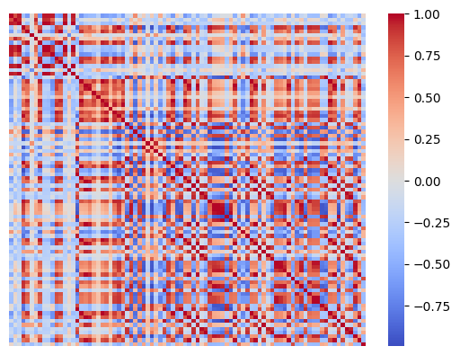
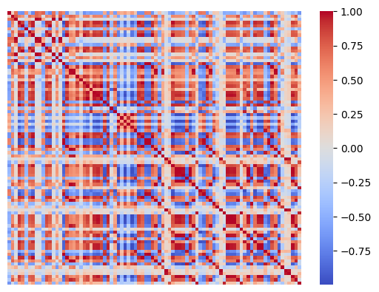
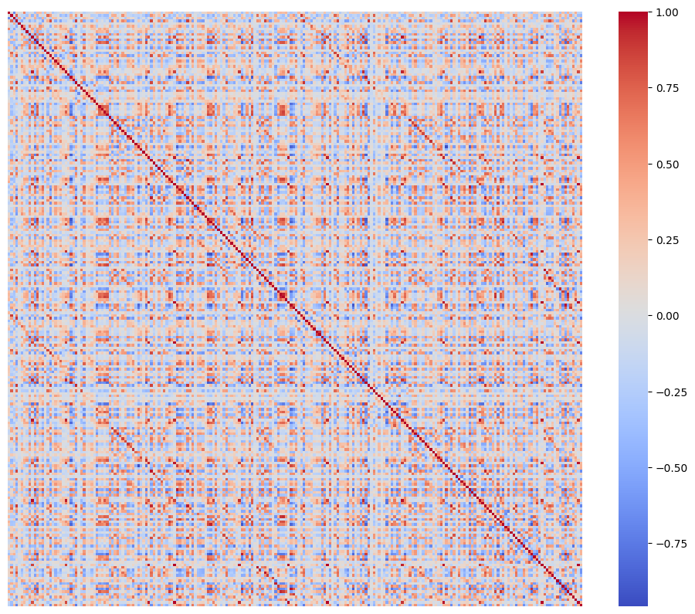
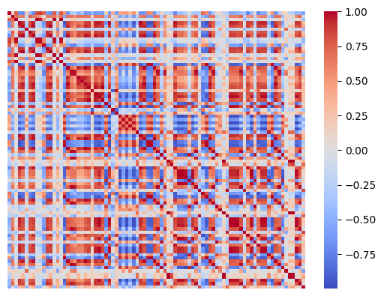
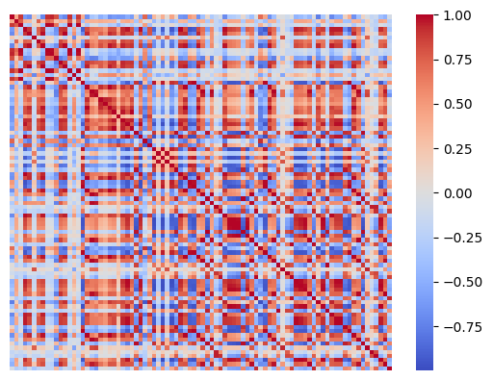
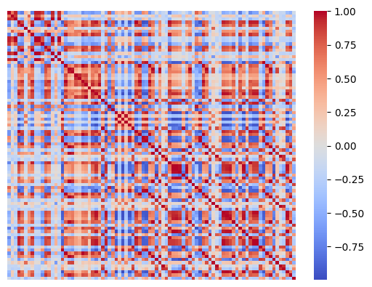
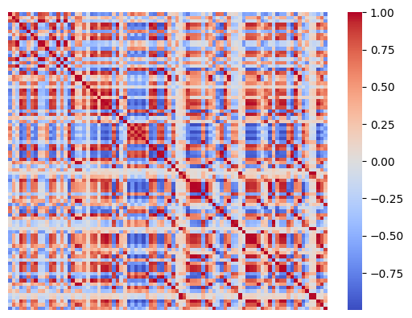
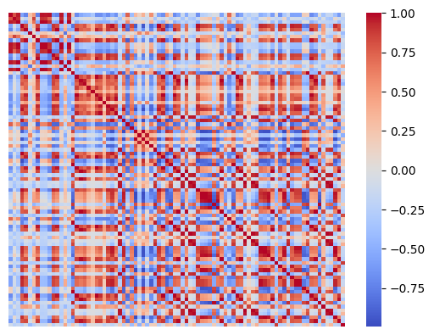
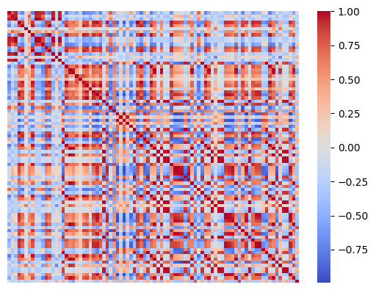
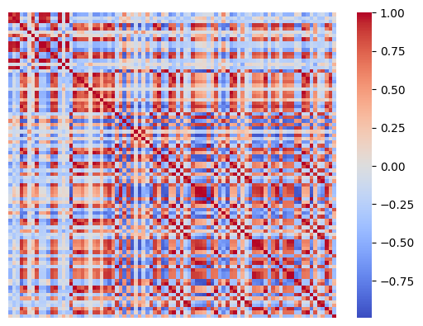

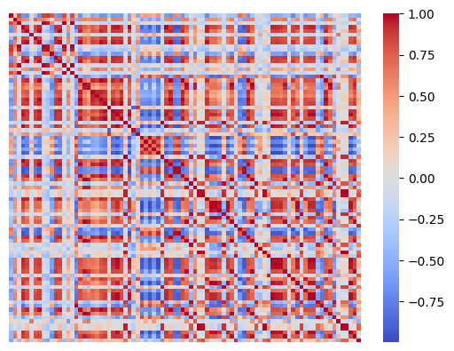
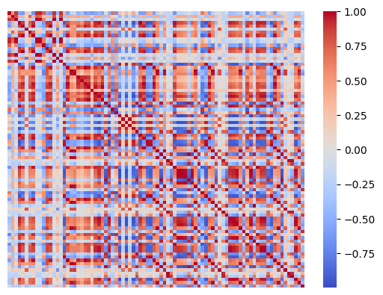
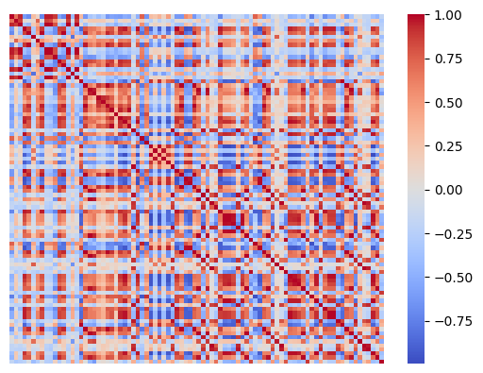

Pipeline: Feature Selection
Correlation
mRMR
LASSO
RFE
N=222
Top 50
N=5
N=4
Drop when
|corr|>0.8
Drop the one with
smaller spearman r
86x16
222

Slide 16
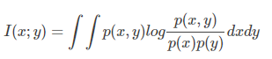
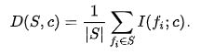
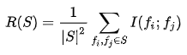
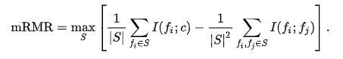
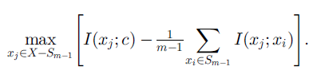
Pipeline: Feature Selection
Correlation
mRMR
LASSO
RFE
N=222
Top 50
N=5
N=4
最大相关-最小冗余特征选择：在存在其他所选特征的情况下通过其冗余来惩罚特征的相关性
互信息：
特征集S与类c的相关性：
各特征与类c间所有互信息值的平均值
给定一组特征，在剩余特征中找到使上式最大的特征，并以此排序
特征集S中所有特征的冗余：
各特征间所有互信息值的平均值

Slide 17
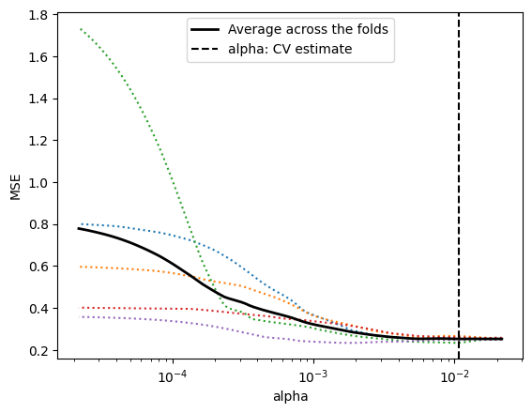
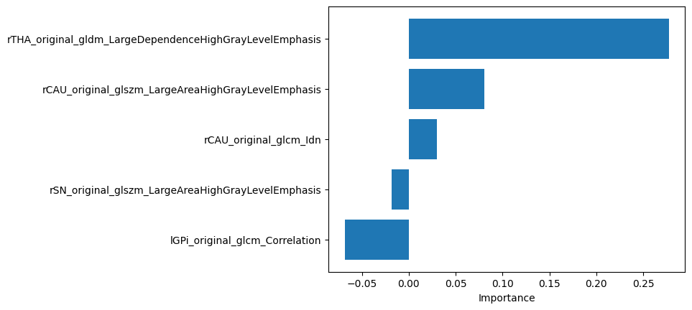
Pipeline: Feature Selection
Correlation
mRMR
LASSO
RFE
N=222
Top 50
N=5
N=4
LassoCV
Lasso
Optimal alpha: 0.0108

Slide 18
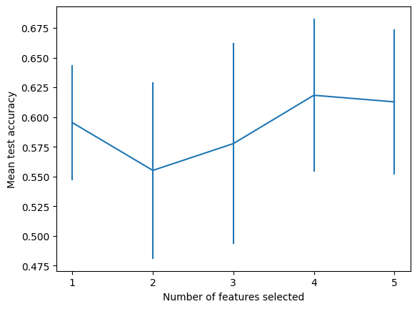
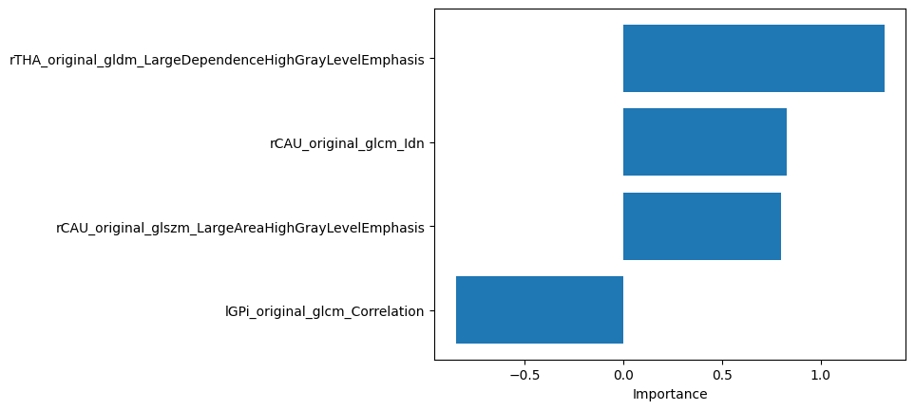
Pipeline: Feature Selection
Correlation
mRMR
LASSO
RFE
N=222
Top 50
N=5
N=4
递归式特征消除：反复建立模型，根据系数排除表现较差特征，在剩余特征上重复该过程
RFECV
Estimator:
Logistic Regression

Slide 19
Pipeline: Feature Selection
Initial
Correlation
mRMR
LASSO
RFE
N=86*16
N=222
Top 50
N=5
N=4
Selected Features: rTHA_original_gldm_LargeDependenceHighGrayLevelEmphasis
lGPi_original_glcm_Correlation
rCAU_original_glszm_LargeAreaHighGrayLevelEmphasis
rCAU_original_glcm_Idn

Slide 20
Pipeline: Selected Features
rTHA_original_gldm_LargeDependenceHighGrayLevelEmphasis:
Measures the joint distribution of large dependence with higher gray-level values.
lGPi_original_glcm_Correlation:
The linear dependency of gray level values to their respective voxels in the GLCM.
rCAU_original_glszm_LargeAreaHighGrayLevelEmphasis:
Measures the proportion in the image of the joint distribution of larger size zones with higher gray-level values.
rCAU_original_glcm_Idn:
Measure of the local homogeneity of an image. IDN normalizes the difference between the neighboring intensity values by dividing over the total number of discrete intensity values.

Slide 21
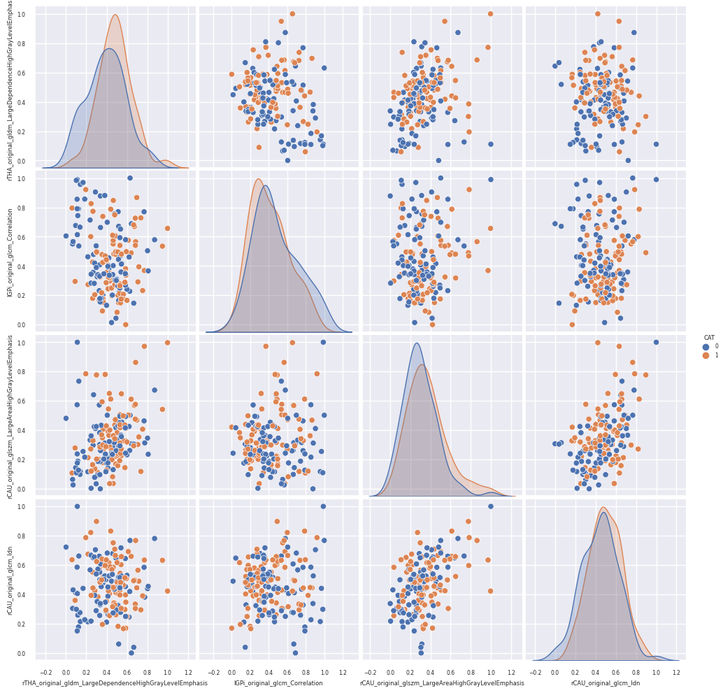
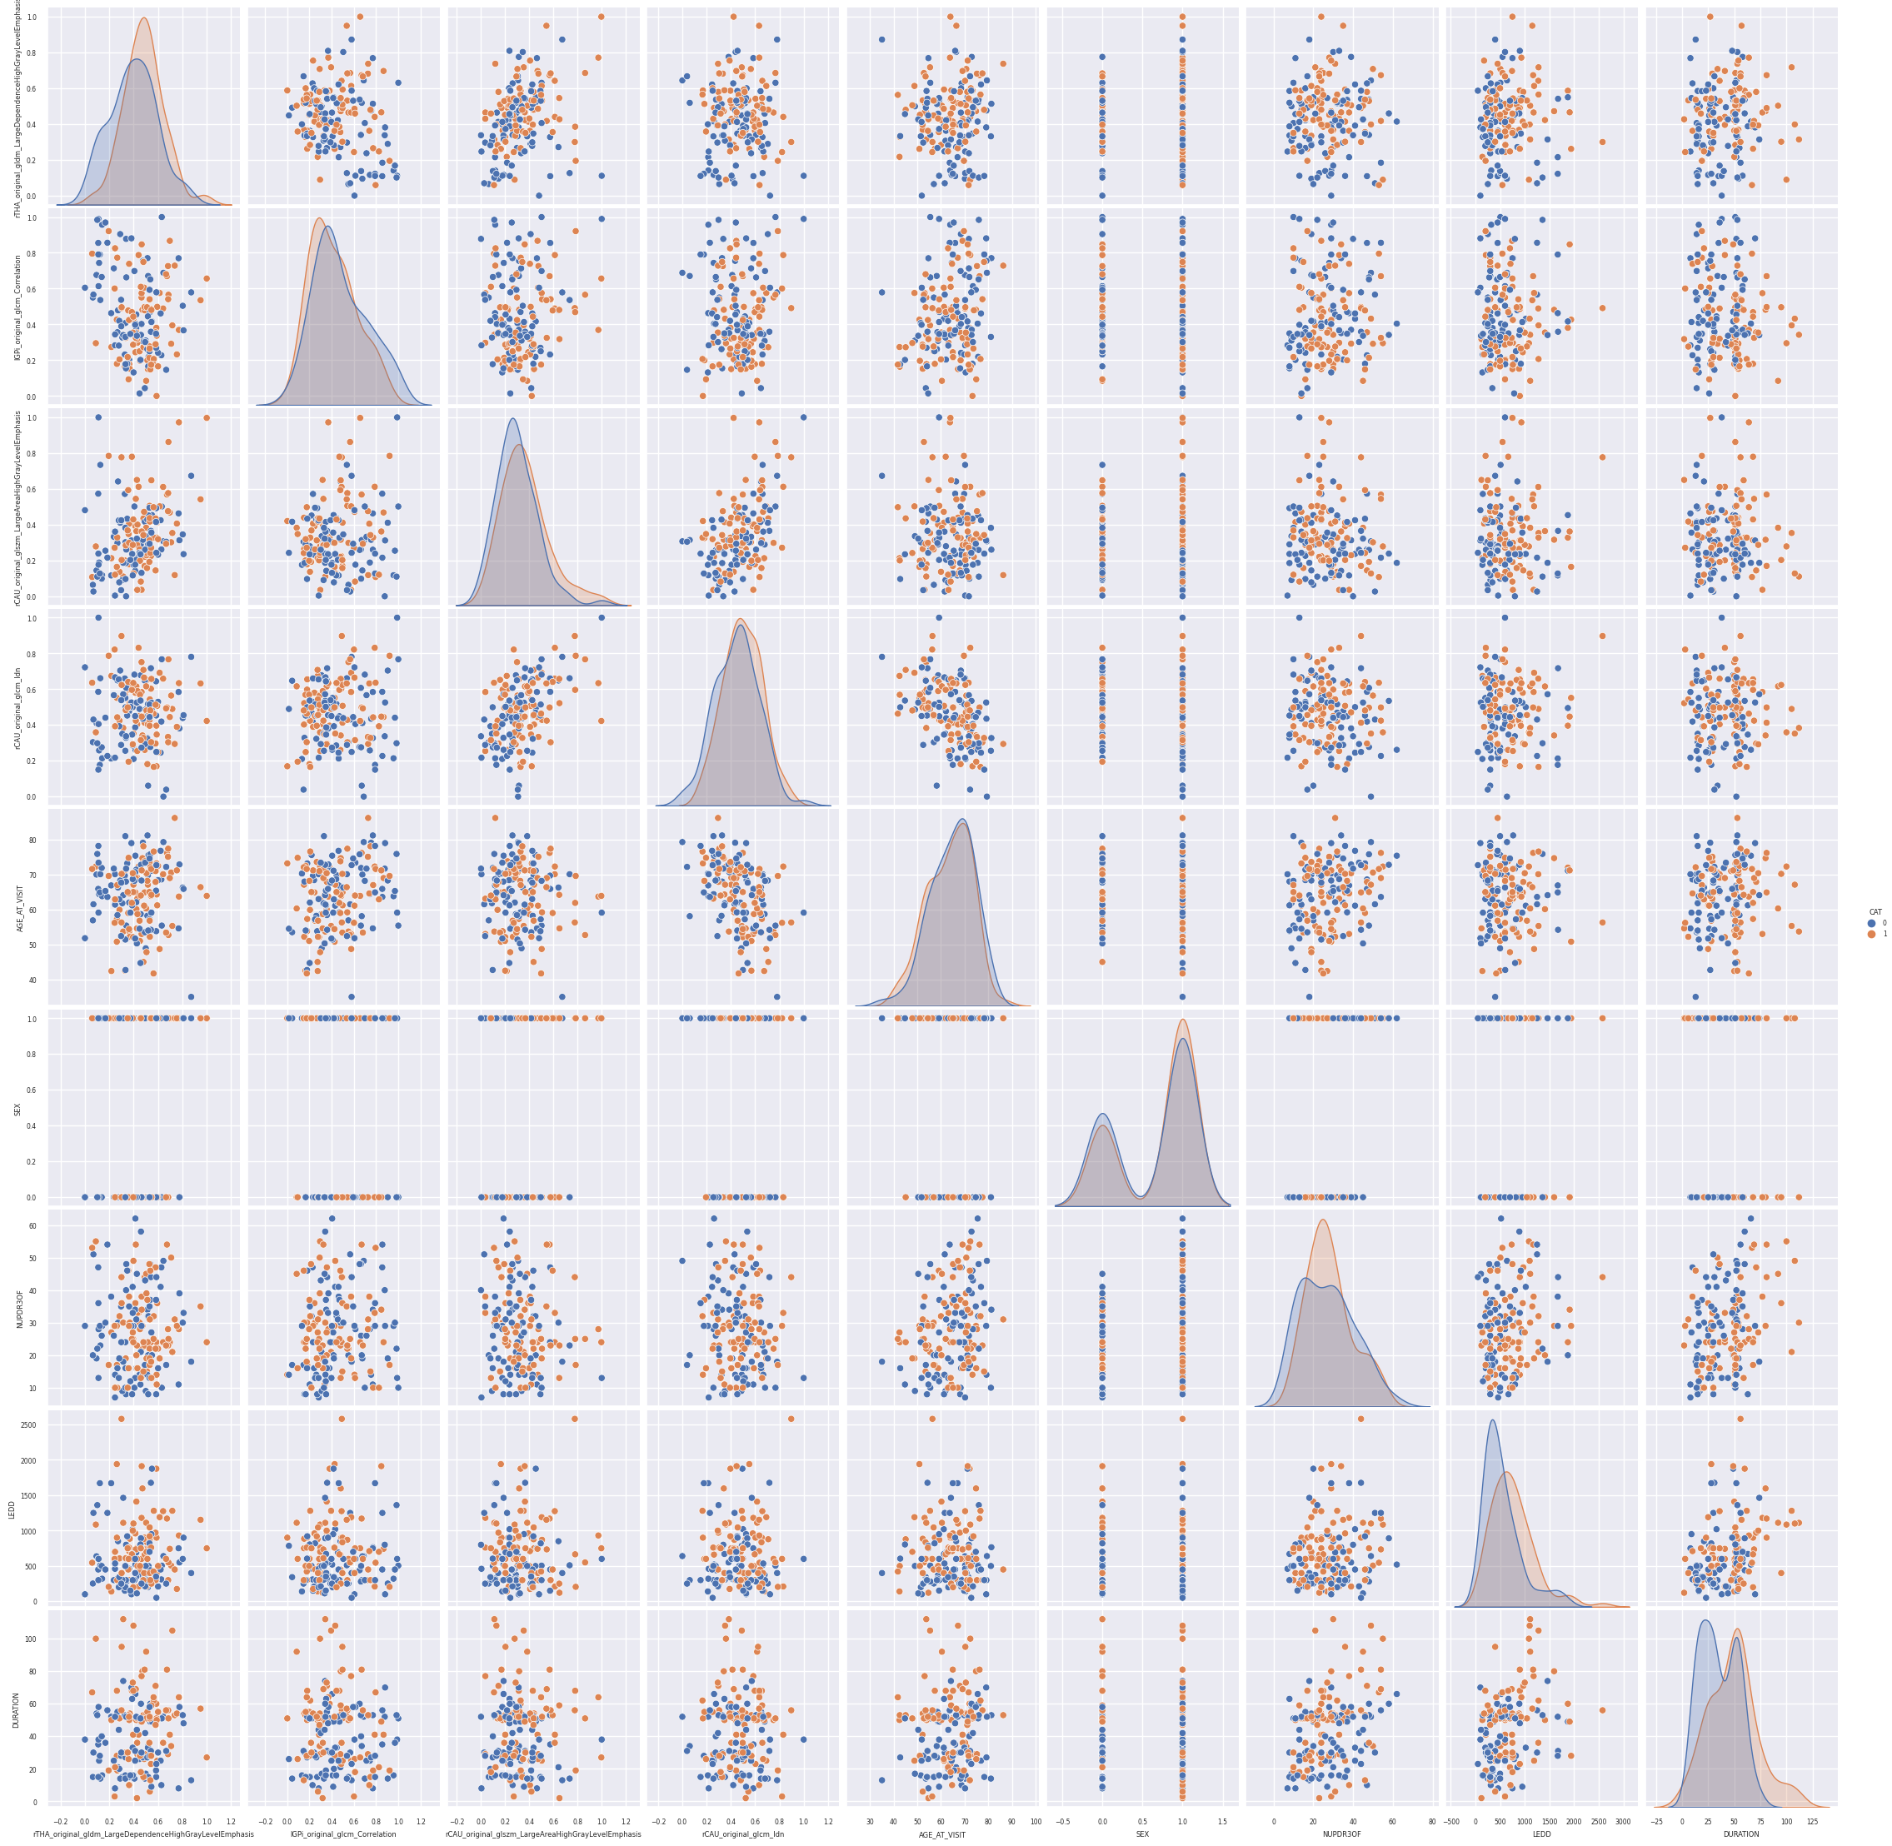
Pipeline: Selected Features

Slide 22
Pipeline: Classification
Test Set
Pos 22/Neg 24
5-fold CV
Classifiers
Prediction
Logistic
SVM
Optimal
Hyperparameters
Train
y_true
y_pred
XgBoost
Bootstrap N=1000
Train Set
AUC CI, p-value
Pos 86/Neg 87

Slide 23
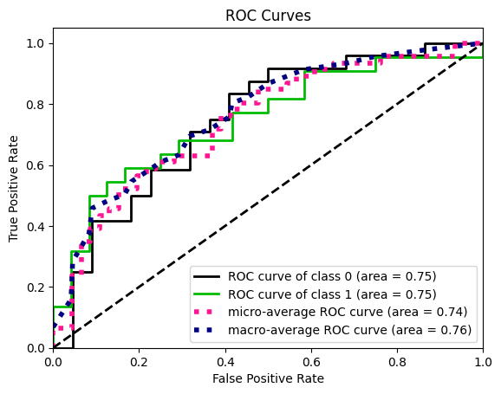
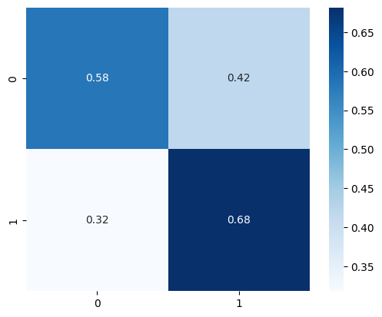
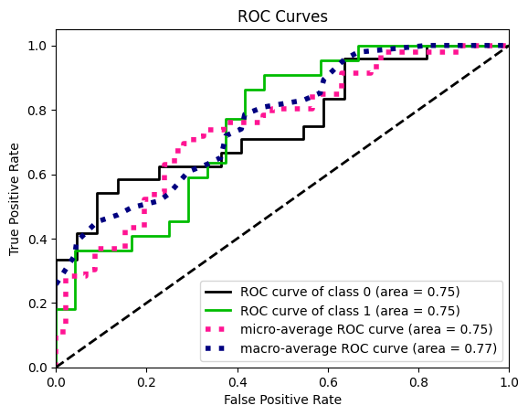
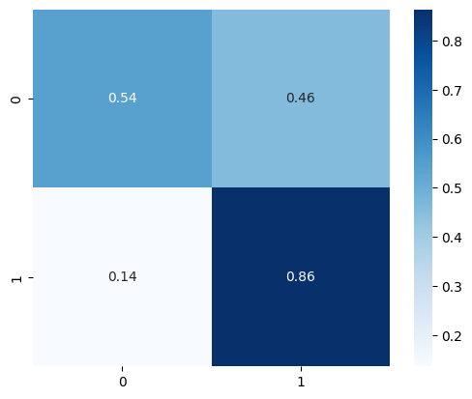
Results: Logistic Regression w/ mRMR + LASSO + RFE
Demo+Clinic+Img > Demo+Clinic:
p-value = 0.012
Demo+Clinic:
AUC train: 0.71
95% CI: [0.63, 0.78]
AUC test: 0.75
95% CI: [0.59, 0.87]
Demo+Clinic+Img:
AUC train: 0.77
95% CI: [0.70, 0.83]
AUC test: 0.75
95% CI: [0.61, 0.88]

Slide 24
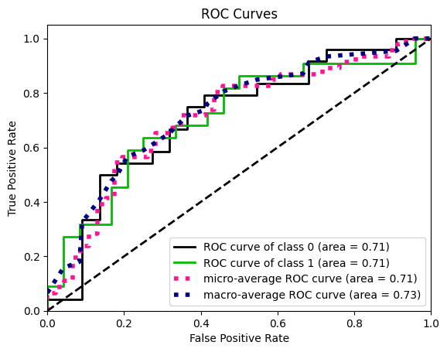
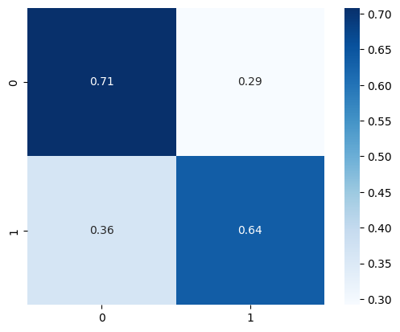
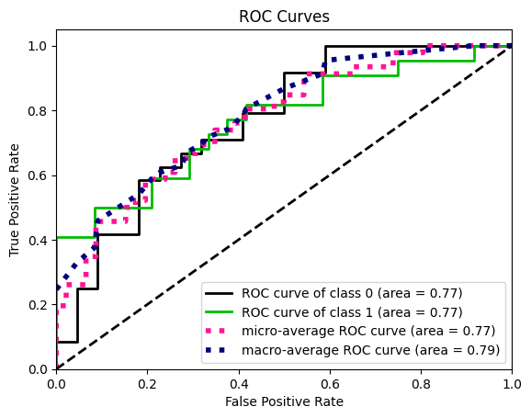
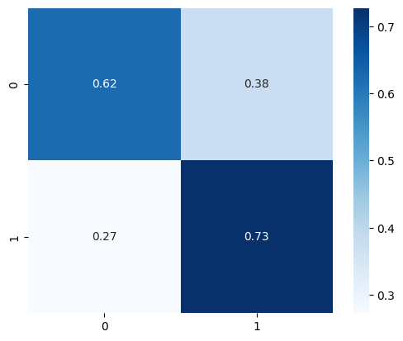
Results: SVM w/ mRMR + LASSO + RFE
Demo+Clinic+Img > Demo+Clinic:
p-value < 0.01
Demo+Clinic:
AUC train: 0.77
95% CI: [0.68, 0.83]
AUC test: 0.71
95% CI: [0.54, 0.85]
Demo+Clinic+Img:
AUC train: 0.82
95% CI: [0.75, 0.87]
AUC test: 0.77
95% CI: [0.62, 0.89]

Slide 25
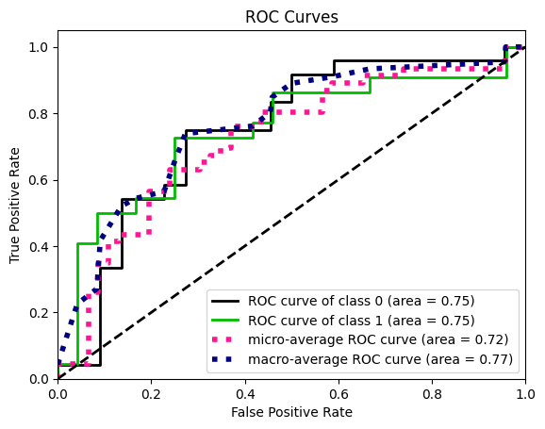
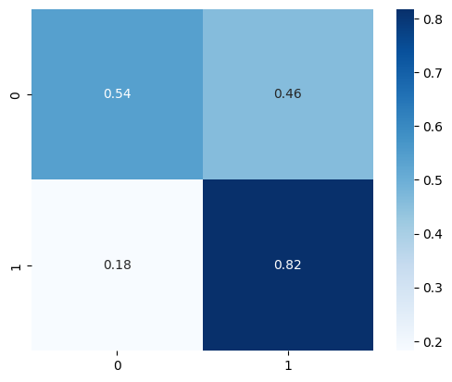
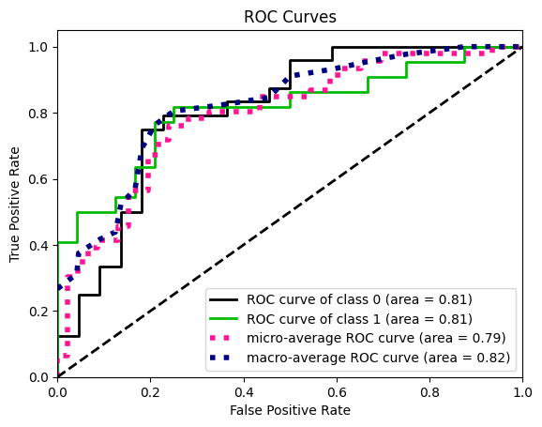
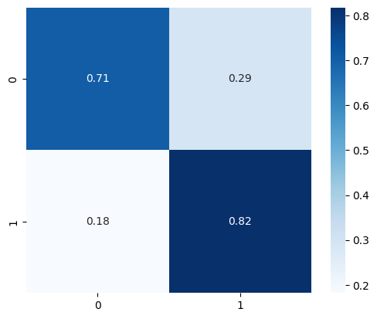
Results: XGBoost w/ mRMR + LASSO + RFE
Demo+Clinic+Img > Demo+Clinic:
p-value < 0.01
Demo+Clinic:
AUC train: 0.97
95% CI: [0.93, 0.98]
AUC test: 0.75
95% CI: [0.60, 0.89]
Demo+Clinic+Img:
AUC train: 1.0
95% CI:
AUC test: 0.81
95% CI: [0.65, 0.91]

Slide 26
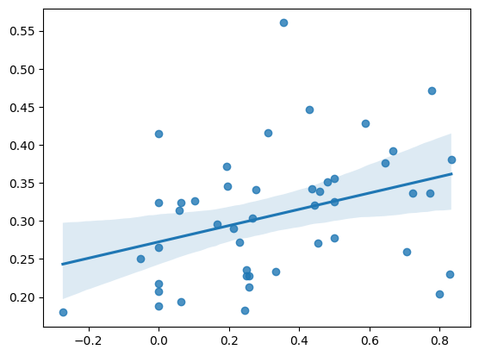
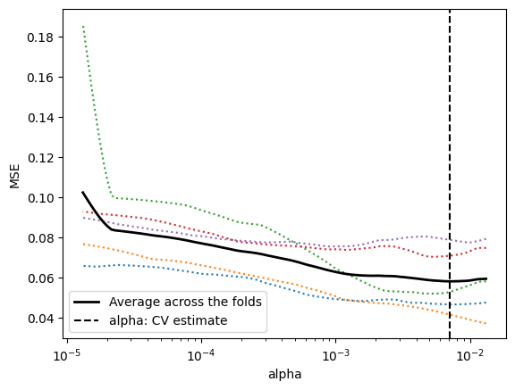
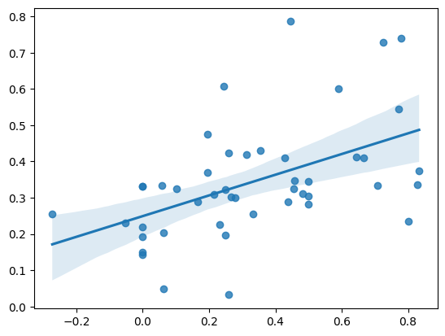
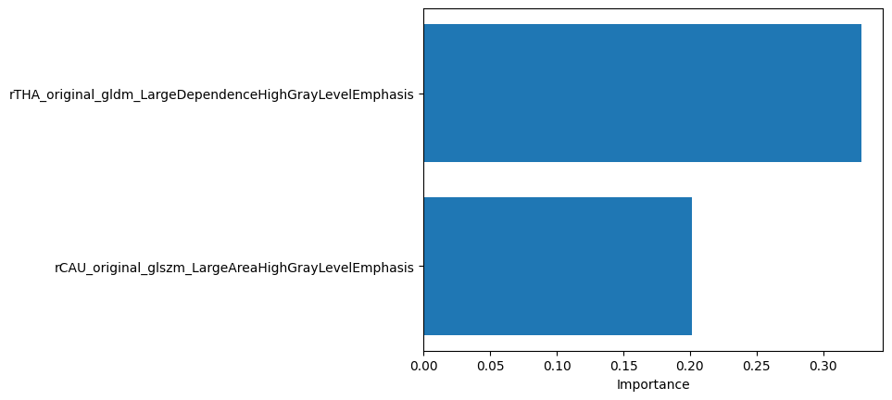
Results: Linear Regression w/ mRMR+LASSO+RFE
Demo+Clinic:
r2 train: 0.12
r2 test: 0.11
Demo+Clinic+Img:
r2 train: 0.22
r2 test: 0.24

